Slide 1



Bank-Customer Analysis & Insights Dashboard
Analyzing customer demographics, product usage, transaction patterns, and customer segmentation
to drive meaningful insights and identify trends that can drive business decisions.
By Omkar Rahate

Slide 2

Problem Statement & Objective
Problem Statement:
Banks need to better understand their customer behaviors, spending patterns, and product usage to optimize customer retention, improve services, and boost profitability. Without proper analysis, banks risk losing customers due to unmet needs, ineffective targeting, and lack of personalized services.
Objective:
The objective of this project is to create a comprehensive dashboard in Power BI that provides actionable insights into bank customer behaviors and trends. This includes analyzing customer demographics, product usage, transaction patterns, and customer segmentation. The dashboard aims to help bank executives and decision-makers Identify high-value customers, monitor customer retention and exit patterns, understand which products are most/least used by customer segments.

Slide 3


Customers distribution in Different Locations
2509
SPAIN
5014
Spain is the region having smallest count of customers
2477
Germany
FRANCE
Germany is the region which has second largest customers
France is the region which has highest customers

Slide 4


Distribution of Credit Card holders
Retain
Active
3126 customers
There are 5632 customer retained in the bank
Inactive
2507 customers
Credit card Holders
There are 7056 Customers having credit cards.
EXIT
Active
483 customers
There are 1425 customers exits the bank.
Inactive
943 customers

Slide 5
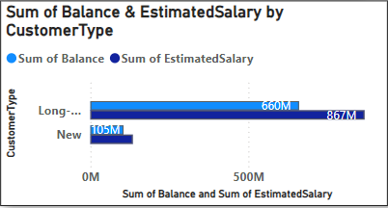
Customer Behaviour Analysis
Long-term customers (Tenure > 3 years) has higher account balances and salaries, indicating strong customer loyalty. Customer with High salaries are less likely to churn, making them prime targets for loyalty programs. Develop targeted engagement strategies to maintain and grow these high-value segments.

Slide 6
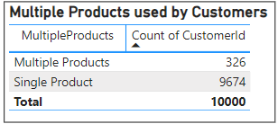
Product Affinity Study & Cross-Selling Opportunities
Customers with more than 2 products are considered multiple product users which are way less as compared with single products users. So Cross-selling strategies can focus on customers with multiple products to enhance engagement. Introduce tailored product bundles or promotions that align with the customers' profiles and needs.

Slide 7
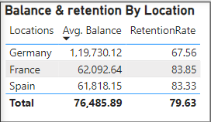
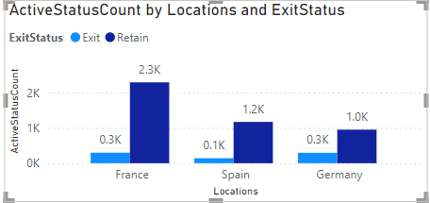
Geographic Insights and Market Expansion
Customer retention & Avg. balance varies significantly across different geographic regions. Regions with lower retention rates may require customized engagement strategies. So Focus on region-specific campaigns that address local customer needs and preferences.

Slide 8
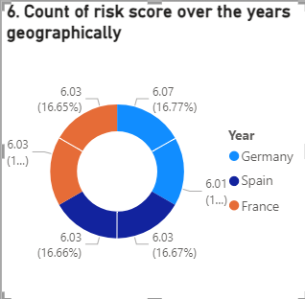
Risk Management Assessment
Higher financial risk is linked to lower tenure, Estimated salary and Number of products, segmented by gender and geography. Implement proactive programs for high-risk demographics to reduce financial risk

Slide 9
Customer Tenure Value Forecast
Tenure value is modeled using age, gender, balance, and tenure, with trends segmented by age and gender.
Conclusion: Understanding customer tenure can guide personalized relationship management strategies.

Slide 10
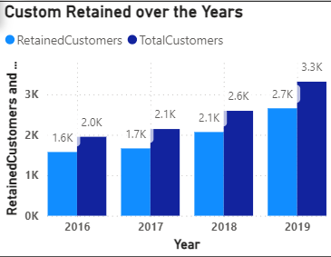
Marketing Campaign Effectiveness
Retention rates over time provide insights into the effectiveness of marketing campaigns. Enhanced data on campaign specifics would improve the assessment of marketing effectiveness.

Slide 11
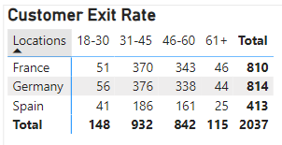
Customer Exit Reasons Exploration
Customers ages 31- 45 show higher exit rates. Retention efforts should focus on such customers, addressing their specific needs and concerns. Leverage predictive analytics to refine customer engagement strategies and reduce churn.

Slide 12
Important Predictors for Customer Exit
Variables like Tenure, Number of Products, Member Status, and Estimated Salary play roles in predicting customer exits.
Conclusion: As some of the important data such as joining date, exit date, product names, customer complaints, Late & missed payments. A deeper analysis using advanced data-driven techniques could better predict and prevent customer churn.

Slide 13
Strategies to Decrease Churn Rate
Recommendations:
Enhance Customer Engagement
Personalized offers and rewards.
Cater to diverse customer needs.
Offer bundled services at a discounted rate.
Proactive support and regular feedback.
Targeted interventions for at-risk customers.
Financial planning Advisory services to build customer trust.

Slide 14
Conclusion
Summary: Key insights and strategies for improving customer retention, managing risk, and enhancing customer engagement.
Action to be taken: Implementation of data-driven strategies to improve bank productivity.

